Slide 1
Compliant Plug-In
maxime.tournier@inria.fr
INRIA-DEMAR
and M. Nesme, B. Gilles, F. Faure this document is licensed under CC 4.0 BY-SA

Slide 2
Plan
Introduction
Theory
Implementation Notes
Examples

Slide 3
Introduction
Harmonize ForceFields/Constraints handling
(Re)use mappings as much as possible
Holonomic constraint = infinite stiffness
= zero compliance
Simplify constraint solvers, genericity

Slide 4
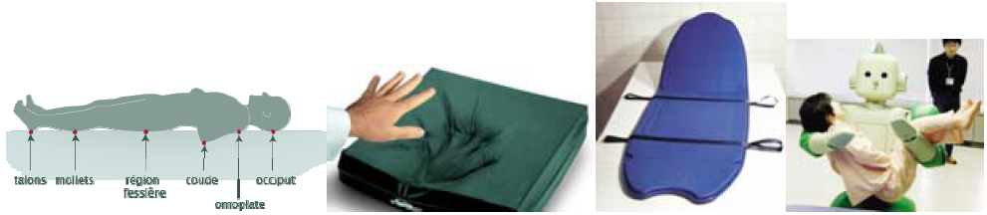
Context
SoHuSim ANR
(Soft Human Simulation)
Human/environment mechanic interactions
Constrained mechanical systems
Rigid/deformable objects
Constraints: bilateral/unilateral/friction/…
Bi-phasic materials
Tendons, ligaments

Slide 5
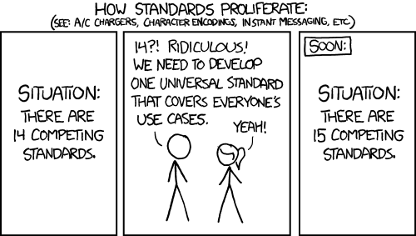
Constraints in SOFA
Projective
FixedConstraint
LMConstraints
constraintset
… ?
Compliant
(xkcd)

Slide 6
Philosophy
Constraint = ForceField
Very (very) stiff !
Mappings do most of the work
No PlaneConstraint, LineConstraint, ...
Instead: PlaneNormalMapping, LineNormalMapping, … + stiff ForceField at the end
Factorize code whenever possible
in the ‘Flexible’ plug-in spirit

Slide 7
Very (very) stiff ?
Stiffness matrix K → +∞
Numerically instable
Compliance : C = inv(K) → 0
Formulate dynamics using compliance

Slide 8
Theory

Slide 9



Time integration
Implicit linear velocity update:
Typically:

Slide 10




Constraints: KKT systems
Holonomic constraint:
Gradients :
Correction :

Slide 11

Elasticity: mapped stiffness
Mapping: g(q)
Apply stiffness matrix K_{g} on mapped dofs g(q)
Stiffness on q is:

Slide 12


Elasticity: compliant KKT system
Compliance:
[Servin06]
Constraints: same system with C = 0

Slide 13
Schur Complement
Assuming H is easily invertible:
“Regularized” constraint system
Smaller than KKT system !
Positive (semi-)definite

Slide 14
In a nutshell
Constraint = stiff ForceField
Handle ForceFields as compliance
Easy transition towards very (very) stiff, C → 0
Numerical solves on KKT or Schur system

Slide 15
Implementation Notes

Slide 16

Compliance API
BaseForceField additions:
bool isCompliance()
BaseMatrix* getComplianceMatrix(...)
For now, complete KKT system assembly
Mapping J matrices must be provided
Will probably change eventually
Not a lot to implement, don’t worry

Slide 17
Solvers
AssembledSystem
OdeSolver
KKTSolver
Integration scheme
Constraint stabilization
...
Velocity / position correction
Lagrange multipliers
...

Slide 18
Numerical solvers
Direct
LDLT, … (courtesy of Eigen library)
Krylov
CG, MINRES
Matrix-splitting
(block) Gauss-Seidel

Slide 19
(More) numerical solvers
Projected Gauss-Seidel
Unilateral/friction constraints
In CompliantDev (ask us):
[Silcowitz-Hansen10]
Speedup PGS + Fletcher-Reeves
[Otaduy09]
Friction + deformable, PGS variant
[Kaufman08]
Staggered Projections

Slide 20
Compliant contacts
Two contact responses:
Unilateral: CompliantContact
Coulomb friction: FrictionCompliantContact
(Only CompliantContact will remain)
Simply tell the ContactManager to use them
To get compliant contacts

Slide 21
Stabilization
Add these next to a compliant ForceField:
odesolver::Stabilization
Ask AssembledSolver for a stabilization pass:
stabilization=”true”

Slide 22
Use Schur complement
Add a Response component next to the KKTSolver
Abstraction of inv(H)
e.g. DiagonalResponse
Naming sucks (we know)
Solvers will use optimized inverse

Slide 23
Python Library
Simplifies scene graph creation *a lot*
For mere mortals
Rigid bodies + most classic kinematic joints
Typical examples:
Spherical joint + angular stiffness + damping
Angular limits

Slide 24
Examples

Slide 25
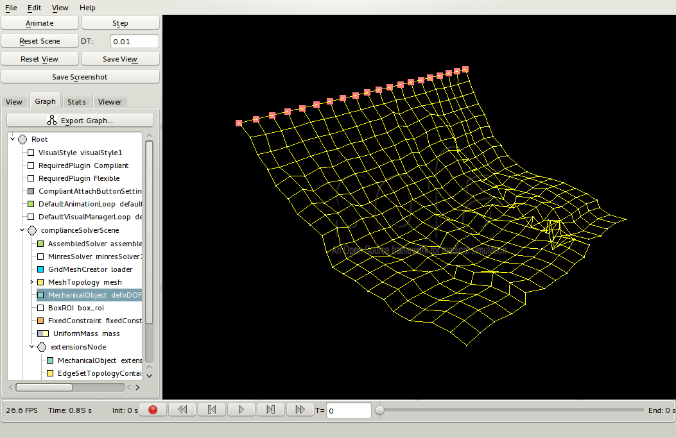
Cloths
Start from a regular 2D mesh
Mesh vertices are point masses
Map relative distances along the mesh edges
Apply UniformCompliance on relative distances
Notes:
TODO image

Slide 26
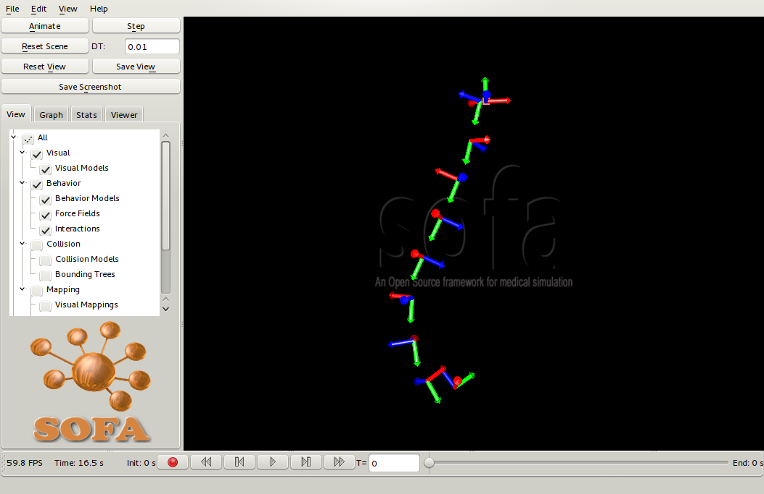
Articulated Chain
Map parent/child rigid frames for the joint
RigidJoint(Multi)Mapping
= joint dofs
UniformCompliance on translation part
[+Stabilization] to avoid drift
Notes:
TODO image

Slide 27
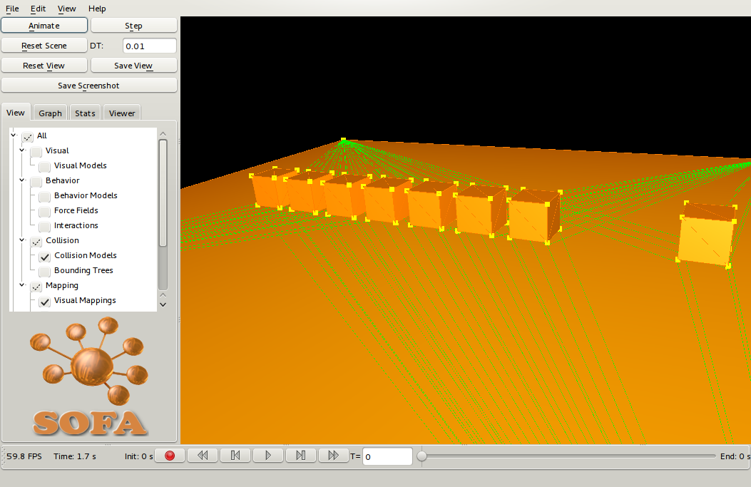
Contacts
Map contact point pairs, relative distances
Apply UniformCompliance
[+ Stabilization]
[+ Restitution]
Unilateral constraint:
+ UnilateralConstraint
Notes:
TODO image/vidéo ?

Slide 28
Discussion
Unified elasticity/constraint handling
(re)use mappings whenever possible
Minor modifications to existing code

Slide 29
Discussion
Lots of components !
Options would only make it worse
No “default” configuration
Python helps *a lot*
Assembly = slow, but:
Simplified solver implementation
Generic
“easy” parallelization

Slide 30
Final remarks
Plays along nicely with the Flexible plug-in
Currently under refactoring !
Cleaning !
Documentation ! yay !
Wait a couple of weeks before using :-)
Python >> XML
Wrap gory details into a nice user API

Slide 31
Thank you !
maxime.tournier@inria.fr

